Slide 1


Slide 2
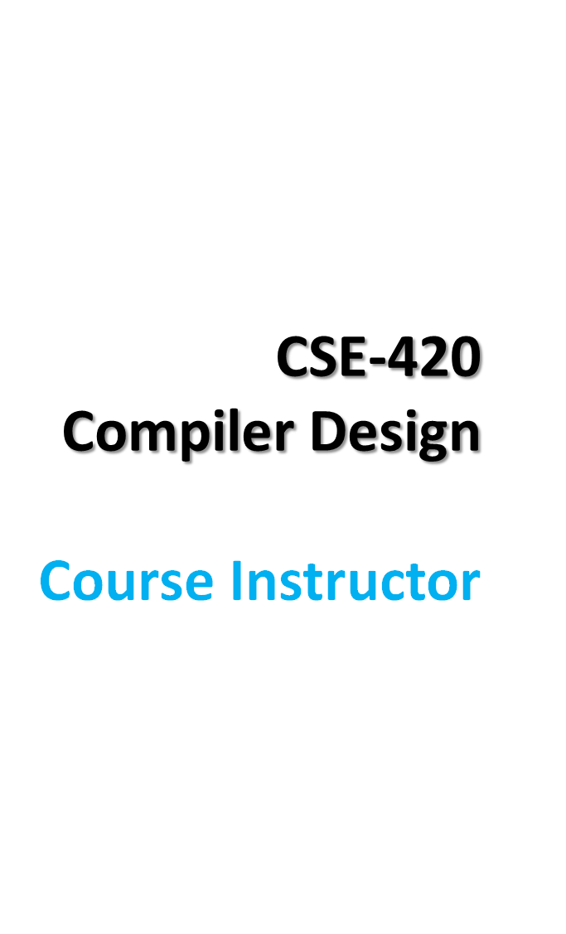
  Iffat Anjum (IFF)
  Formal Email:
    iffat@bracu.ac.bd
    iffat.16.cse@gmail.com
  Submission Email: iffat.submission@gmail.com
  Phone: 01814928290
  Google Group:
    CompilerDesignBRACU
    https://groups.google.com/forum/#!forum/compilerdesignbracu

Slide 3
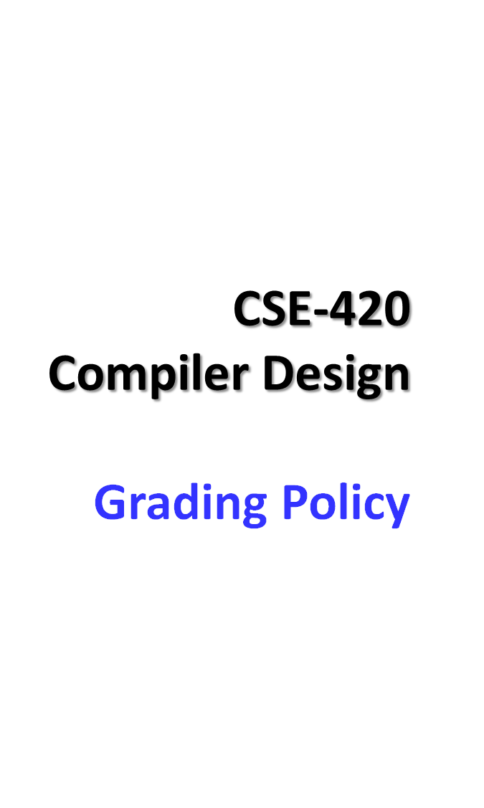
35% - Final Examination
25% - LAB performance
20% - MID Examination
8% - Assignment & Surprise Quizzes
7% - Declared Quizzes
5% - Attendance
No students will be allowed to sit for final examination if he/she has less than 70% attendance in LAB Class and less than 75% attendance in Theory Class

Slide 4
Surprise Quizzes
There will be surprise quizzes, given at the start of a lecture, during any lecture.
NO LATE or MAKEUP SURPRISE QUIZZES, under any circumstances whatsoever.
Surprise quizzes are completely individual efforts.
Your best strategy is to play it safe – attend every lecture.

Slide 5
Assignments
Assignments need to be hand-written. I will not accept typed up solutions.
Assignments are completely individual efforts.
  If two written solutions are the same or similar, both will be penalized (100% penalty for the entire assignment).
  If a written solution is similar or same as an online or other solution resource, you will be penalized (100% penalty for the entire assignment).

Slide 6
Playing it safe in
CSE-420
If you follow these 4 simple rules during the class, you'll make sure that you do well in the course:
Attend every Theory and LAB classes.
Read the course material (textbook sections assigned + slides).
Submit everything (Assignments, Quizzes, Exams) on time - don't be late.
Don't cheat.

Slide 7
Quizzes and Exams
Three Quizzes
Several Surprise Quizzes
If you fail to attend any exam you will get 0 (zero) on that exam.
No makeup exams unless with documented medical emergency.

Slide 8
Pre-requisite Knowledge
Strong programming background in C, C++ or Java
Some background on Automata Theory (NFA, DFA, CFG) is recommended…… ……not mandatory
Assembly Language Programming and Machine Architecture

Slide 9
Recommended Books
Aho, Lam, Sethi, Ullman:
Compilers: Principles, Techniques, and Tools
(2nd Edition)

Slide 10
The Course covers
Compiler Basics
Lexical Analysis
Syntax Analysis
Semantic Analysis
Runtime environments
Code Generation
Code Optimization

Slide 11
Question?

